Slide 1




Predicting Europe’s Weather Patterns with Machine Learning
Andrew Fearney 10th September 2024

Slide 2

Objectives and Overview
Objective: Harness machine learning to predict weather trends in Europe, focusing on abnormal weather shifts, long-term changes, and identifying safer regions.
Overview:
Build models based on historical weather data.
Utilise predictive techniques to understand potential future weather risks.
Prioritise regions based on risk factors derived from predictions.

Slide 3
Algorithm Overview: Machine Learning Tools
CNN (Convolutional Neural Networks)
How they Work: CNNs use convolutional layers to automatically detect important features in the input data. For example, in image data, a CNN could learn to recognise different cloud formations, which can be linked to specific weather conditions
RNN (Recurrent Neural Networks)
How they Work: Unlike traditional neural networks, RNNs have loops in their architecture, allowing them to maintain memory of previous inputs. This makes them effective at capturing the temporal relationships between sequential data points
Random Forests
How they Work: The model randomly selects subsets of the data and features to create individual decision trees, and the predictions from these trees are combined to form the final output

Slide 4

Thought Experiment 1 - Identifying Deviations in Weather Patterns
Concept: Investigate deviations from historical weather norms to understand climate shifts in Europe.
Data Needed: Historical weather data (100+ years).
Algorithms:
Random Forests: For feature importance and anomaly detection.
CNNs: Analyse spatial deviations in weather conditions across Europe.
Visual: A small heatmap showing historical weather anomaly distribution.

Slide 5

Thought Experiment 2 - Analysing Trends in Unusual Weather
Concept: Analyse whether unusual weather patterns (storms, heatwaves) are becoming more frequent and intense.
Data Needed: Time-series weather data for the past decades.
Algorithms:
LSTMs: For time-series trend analysis and long-term weather predictions.
Random Forests: For feature ranking and understanding influencing weather factors.
Visual: A line graph showing increasing trends of extreme weather events.

Slide 6

Thought Experiment 3 - Projecting Future Climate Scenarios
Concept: Simulate future weather patterns and predict which regions in Europe will be safe or at risk
Data Needed:
Historical and current weather data for prediction
Geographic data and climate change projections
Algorithms:
GANs: Simulate future weather scenarios based on various climate factors
Decision Trees: For risk categorisation of regions (high-risk vs. low-risk)
Visual: A decision tree showing the classification of European regions based on projected climate risk

Slide 7

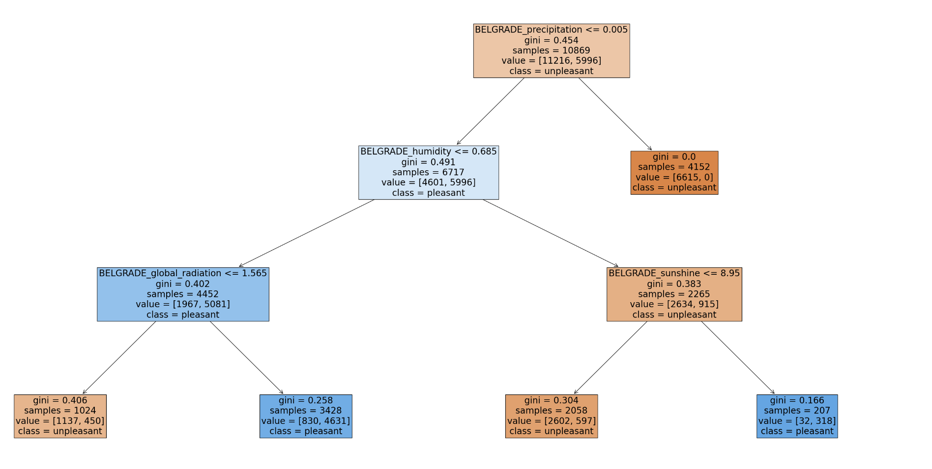
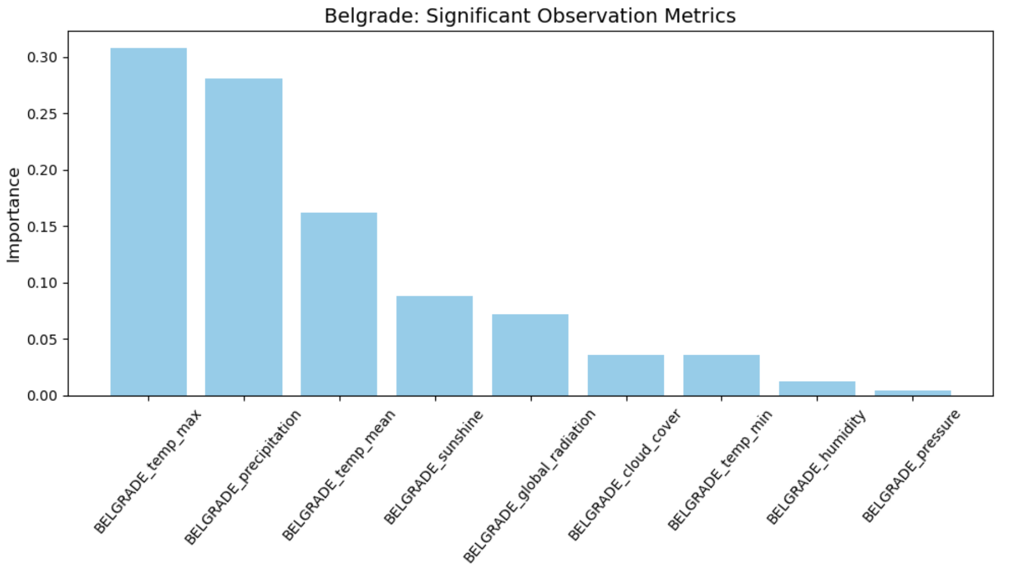
Example: Predicting Future Weather Scenarios for Belgrade
Accuracy: 99%

Slide 8

Data Requirements for Prediction
Data Needed:
Historical weather data (temperature, precipitation, wind, humidity) from reliable sources
Geographic and topographic data to better predict localized weather impacts
Environmental data related to greenhouse gas emissions and global warming projections
Additional Considerations:
Need to update the models regularly with real-time data for improved accuracy
Use external datasets like satellite imagery for more comprehensive predictions

Slide 9

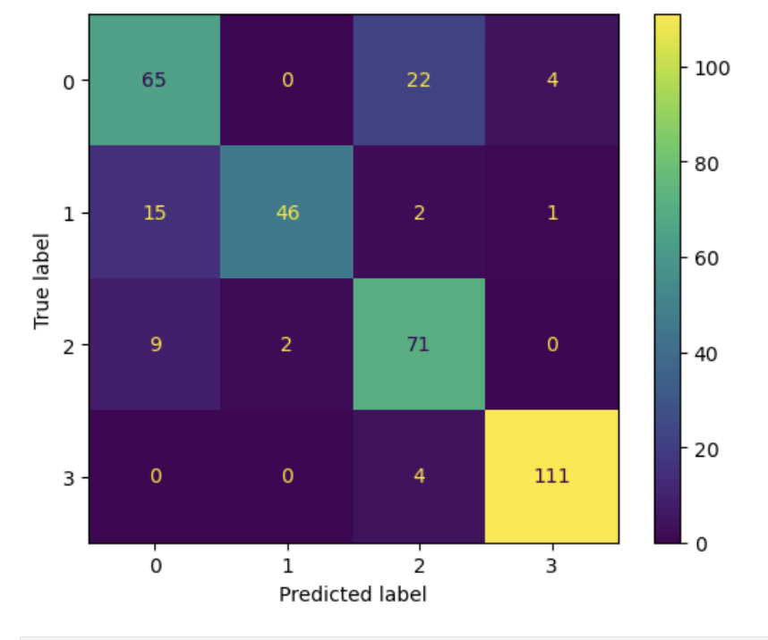

What could this look like in practice?
Confusion Matrix Analysis:
This confusion matrix represents the performance of a CNN (Convolutional Neural Network) in categorising different weather conditions.
Incorrect Prediction (Beach Image):
The confusion matrix shows that 22 instances of class 0 were incorrectly classified as class 2, which may represent an error similar to this beach image.

Slide 10
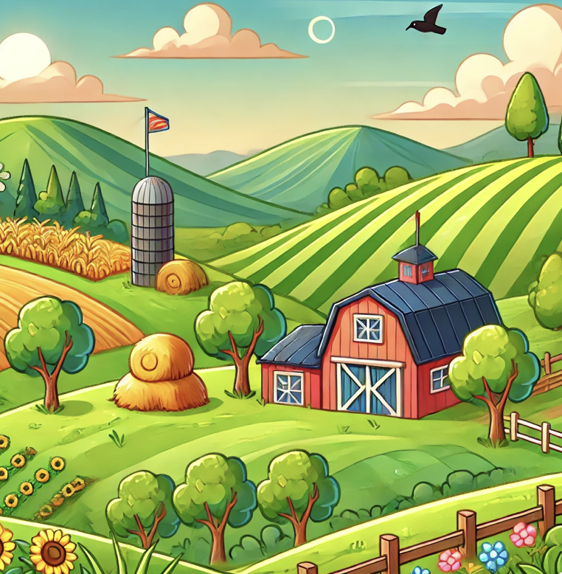
Recommendations and Next Steps
Best Performing Models: CNN for spatial anomaly detection, LSTM for long-term trend analysis, and GAN for future scenario generation
Recommendations:
Continue enhancing models by incorporating real-time weather data
Focus on regions with higher risks for early warning systems
Work with environmental agencies to validate predictions and improve disaster preparedness

Slide 11
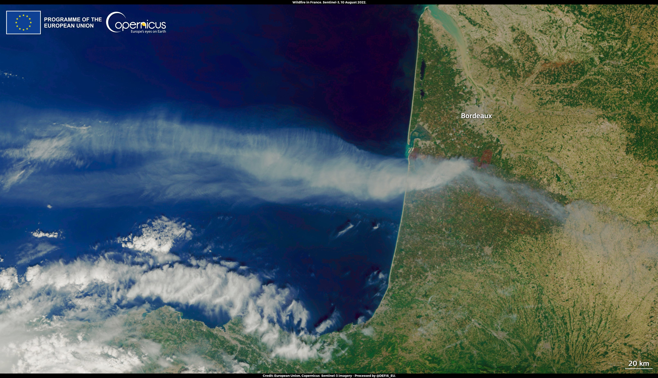
Questions? Thank You

